Slide 1
8/31/2020
Week_2_Control_structure.ipynb - Colaboratory
IF statement
grade = 85
if grade>=60: print("passed")
passed
If else statement
grade =85
if grade>=60: print("passed")
else:
print("fail")
passed
Code
Text
Conditional expression
result = ('Passed' if grade >= 60 else 'Failed') print(result)
Passed
IF...elif....else statement
Flowchart of if...elif...else

Slide 2
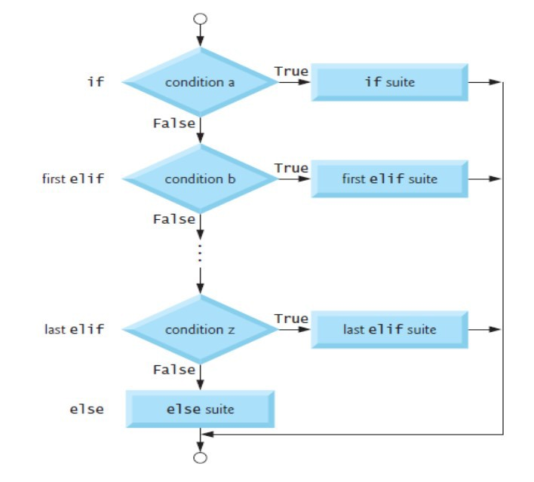
8/31/2020
Week_2_Control_structure.ipynb - Colaboratory
 | grade = 77 if grade >= 90: print('A') elif grade >= 80: print('B') elif grade >= 70: print('C') elif grade >= 60: print('D') else: print('F')
 |  | C

Slide 3
8/31/2020
Week_2_Control_structure.ipynb - Colaboratory
While Statement
number = 1
while (number<10):
print(number, end=" ") #print in same line with space using end =" " number+=1
1 2 3 4 5 6 7 8 9
while statement to find the first power of 3 larger than 50:
product = 3
while product<=50: product = product*3
print(product)
81
For statement
for character in "programming": print(character, end=" ")
p r o g r a m m i n g
Built in Range Function
Let’s use a for statement and the built-in range function to iterate precisely 10 times, displaying the values from 0 through 9:
for counter in range(10): print(counter, end=" ")
0 1 2 3 4 5 6 7 8 9

Slide 4
8/31/2020 Week_2_Control_structure.ipynb - Colaboratory
Use the range function and a for statement to calculate the total of the integers from 0 through 1,000,000.
total = 0
for number in range(1000001): total = total+number
print(total)
500000500000
Function range also has two- and three-argument versions. As you’ve seen, range’s one argument version produces a sequence of consecutive integers from 0 up to, but not including, the argument’s value. Function range’s two-argument version produces a sequence of consecutive integers from its frst argument’s value up to, but not including, the second argument’s value, as in:
for number in range(5,10): print(number, end=" ")
5 6 7 8 9
Function range’s three-argument version produces a sequence of integers from its frst argument’s value up to, but not including, the second argument’s value, incrementing by the third argument’s value, which is known as the step:
for number in range(0,10,2): print(number, end=" ")
0 2 4 6 8
If the third argument is negative, the sequence progresses from the frst argument’s value down to, but not including the second argument’s value, decrementing by the third argument’s value, as in:
for number in range(10,0,-2): print(number, end=" ")
10 8 6 4 2
Number table print using range function
Take an input from user and print the number table

Slide 5
8/31/2020
Week_2_Control_structure.ipynb - Colaboratory
number = int(input())
7
for i in range(1,11): print(number,"X",i,"=",number*i)
7 X 1 = 7
7 X 2 = 14
7 X 3 = 21
7 X 4 = 28
7 X 5 = 35
7 X 6 = 42
7 X 7 = 49
7 X 8 = 56
7 X 9 = 63
7 X 10 = 70
Nested For Loop
for left in range(7):
for right in range(left,7): print("["+str(left)+"|"+str(right)+"]", end =" ")
print()
[0|0] [0|1] [0|2] [0|3] [0|4] [0|5] [0|6]
[1|1] [1|2] [1|3] [1|4] [1|5] [1|6]
[2|2] [2|3] [2|4] [2|5] [2|6]
[3|3] [3|4] [3|5] [3|6]
[4|4] [4|5] [4|6] [5|5] [5|6]
[6|6]
Break statement
for number in range(10): if number==5:
break
print(number, end=" ")
0 1 2 3 4
Continue statement
for number in range(10):

Slide 6
8/31/2020
Week_2_Control_structure.ipynb - Colaboratory
if number==5: continue
print(number, end=" ")
0 1 2 3 4 6 7 8 9
Beginner Problem solving from Uri Online Judge
Uri Online Judge
Some basic problem for practice
Extremely Basic
Area of a Circle
Difference Age in Days

